Slide 1
Delisha
Climate & Environment
By : Germany

Slide 2
01
Delisha Background
Geography, Culture/Language, Brief economic context

Slide 3
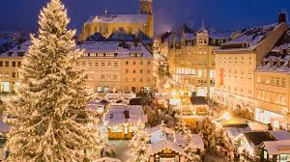
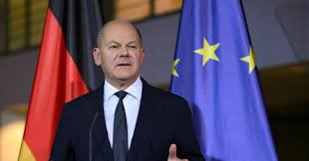
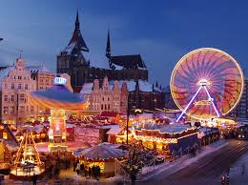
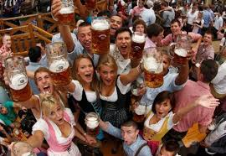
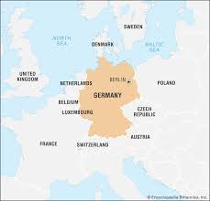
Geography
Culture/Language
Economic Context
Germany is located in Europe, specifically in the central-western region of the continent. Germany has nine neighbouring countries which are, Denmark, Poland, Czech Republic, Austria, Switzerland, France, Luxembourg, Belgium, and the Netherlands. Germany is bounded by the North Sea to the northwest and the Baltic Sea to the northeast. Germany experiences a predominantly temperate climate, characterized by warm summers, cool to cold winters, and moderate, year-round rainfall. Germany’s capital is Berlin.
Germany’s official language is standard german (Hochdeutsch) and is spoken by the vast majority of the population. It's language emphasized structure, oresision, and punctuation. Germany has a love for rich tradition, including world-renowned bread, beer, and festivals. Germany has a population of around 84 million people. The country is known for its Oktoberfest celebrations in Munich, its carnival culture, and their Christmas, also known as, Weihnachten.
The Federal Republic of Germany is made up of 16 federal states, the Lander. The Bundestag is the federal parliament of Germany. It is the only constitutional party in the country directly elected by the people of Germany. The Bundestag was established by Tite III of the Basic Law of the Federal Republic of Germany in 1949. The members of the Bundestag represent all of the German people as a whole, are not forced by any orders or instructions, and are only responsible for their conscience. The Bundestag is elected every four years by the Germans aged 18 and older.
Joachim-Friedrich Martin Josef Merz is the Chancellor of German.

Slide 4
02
The Global Issue
Defining issue, Explaining global importance, Key facts

Slide 5
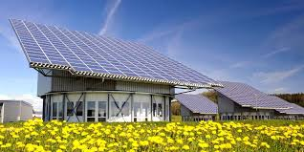
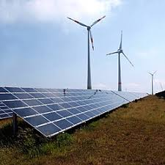

What exactly is the Issue?
Why does it matter Globally?
How does it specifically affected Germany?
Germany is facing several major crises directly tied to Russia og going war with Ukraine. The war has disrupted the major energy supplies from Russia to Germany and impacted shipping to and from German ports. Science Russie historically supplied over half of Germany's natural gas, when Russia cut ties, the industrial strain on Germany grew massive. This pressure caused higher prices and expensive production as many factories couldn’t depend on natural gas anymore.
Germany’s energy challenges matter globally because they affect energy prices, internations trades, climate change efforts, and the security of energy supplies about the world. When Germany needs to replace lost energy supplies quickly, demand and prices for oil and natural gas rise international, affecting many other countries and economies. Germany is also a major manufacturer and exporter. Higher energy costs can increase the prices for products sold around the world. Germany’s energy issue can also impact positively on other countries. Germany’s investments in renewable energy, energy efficiency, and new technologies can influence policies and innovation in other countries.
The war significantly impacted Germany because the country has depended on Russian natural gas for most of its energy. Many German families had to pay higher bills for heating and electricity, and the overall cost of living increased as many goods and services were getting affected by the energy crisis. Many businesses and factories also faced higher costs, more expensive production, and reduced profits. The economic pressure encouraged the government to prompt energy efficiency and cleaner technologies as part of the Energiewende. The Energiewende literally means “energy transition”, it's Germany strategy to transition to a low-carbon, nuclear-free, highly efficient energy economy.

Slide 6
03
Delisha’s Response
Germany’s actions, Evidence, International efforts

Slide 7

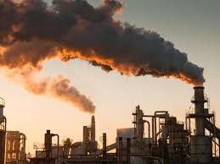
What has the Government actually done?
What has it not done?Why?
Who else is affected by this?
The German government has taken several measures to respond to the energy crisis. The government has given a relief package of 1.7 billion euros for almost all households on January 28 in 2022. Germany built new LNG (liquefied natural gas) terminals so they could import natural gas from other countries such as the United States and Qatar. Germany even requested household and businesses to reduce energy use and promoted financial support to help families and business to cope with the high energy prices. Germany also began to increase its investments in wind and solar power, and continues to work toward long-term goals to make Germany’s energy system cleaner, more secure, and more sustainable.
Even through Germany is trying really hard to only rely on green energy, it has not completely stopped using fossil fuels. Germany still needs a reliable energy source for homes, schools, hospitals, and factories. Renewable energy like solar and wind, cannot produce energy when there to no wing or sunlight. Building these also takes time and money so the country is still lacking backup. Germany has also not stopped concumming Russian LNG. Though it does not directly accept Russian LNG at its own domestic ports, it is still indirectly consuming it through its European Union neighbours and other government-owned entities
ddd

Slide 8
04
Consequences
Intended vs unintended, Short vs long-term, Who affected

Slide 9
What were the Intended & Unintended Consequences?
Who Benefits? Who Suffers?
Short-term & Long-term Effects?
Un
.
.
In
.
.
ede
hihi

Slide 10
05
Canada & Reflection
Canada comparison, Why Canadians should care

Slide 11
Why should Canadian Care?
kko

Slide 12
RESOURCES
Wikipedia Contributors. (2019, May 24). Bundestag. Wikipedia; Wikimedia Foundation. https://en.wikipedia.org/wiki/Bundestag
Clean Energy Wire. (2018, November 29). Germany’s Energiewende in brief. Clean Energy Wire. https://www.cleanenergywire.org/germanys-energiewende-brief
Gross, S., & Stelzenmüller, C. (2024, June 18). Europe’s Messy Russian Gas Divorce. Brookings. https://www.brookings.edu/articles/europes-messy-russian-gas-divorce/
Wehrmann, B. (2022, June 14). What happens if Russia’s gas supplies to Germany are cut? Clean Energy Wire. https://www.cleanenergywire.org/factsheets/what-happens-if-russias-gas-supplies-germany-are-cut

